Slide 1
NoSql vs RDBMS:
Why NoSql is hot
Yiqing Lu

Slide 2
Relational database management system (RDBMS)
RDBMS data is structured in database tables, fields and records.
NoSql
Stands for “Not only SQL”
modeled in means other than the tabular relations.
Notes:
RDBMS: . Each RDBMS table consists of database table rows. Each database table row consists of one or more database table fields.
Widely used system: Oracle, MySQL, PostgreSQL
NoSql: widely used system: MongoDB, Apache Cassandra, and Redis.

Slide 3
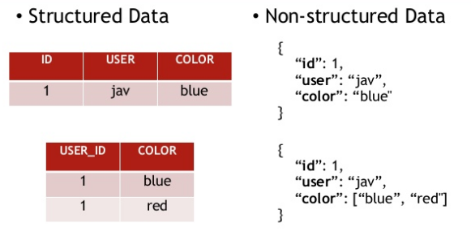

Slide 4
Difference between NoSQL and RDBMS
Data Storage
RDBMS is completely structured way of storing data.
NoSQL is unstructured way of storing the data.
2) Schema
RDMBS models have rigid schemas.
NoSQL models are schemaless
Notes:
1）
RDBMS: It takes data and separates it into many interrelated tables that contain rows and columns. Tables reference each other through foreign keys that are stored in columns as well. When looking up data, the desired information needs to be collected from many tables (often hundreds in today’s enterprise applications) and combined before it can be provided to the application. Similarly, when writing data, the write needs to be coordinated and performed on many tables.
NoSql: take all the data stored in a row that spans several tables of a relational database and aggregate it into a single document/object. More flexible than RDBMS.
2）
RDBMS: when you define the database models using a specific database management software, you need to write a relation schema for each table. In this word, changing the schema is a big deal if data is inserted.
NoSql: dissimilar data could be stored together as well

Slide 5
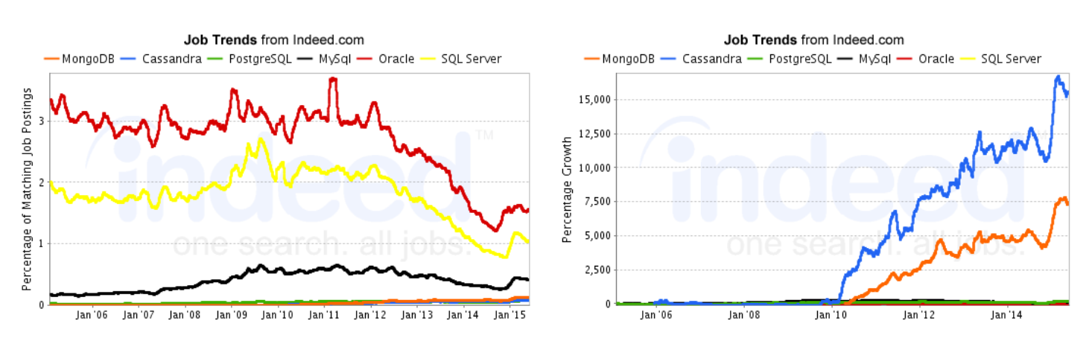
4) NoSql is very hot

Slide 6
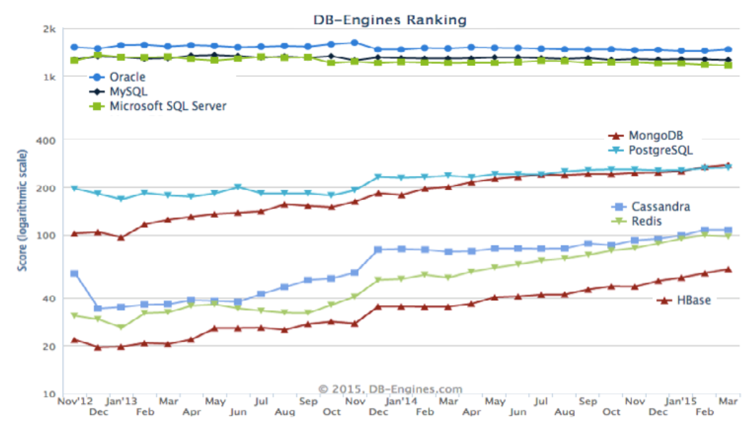
4) NoSql is very hot

Slide 7
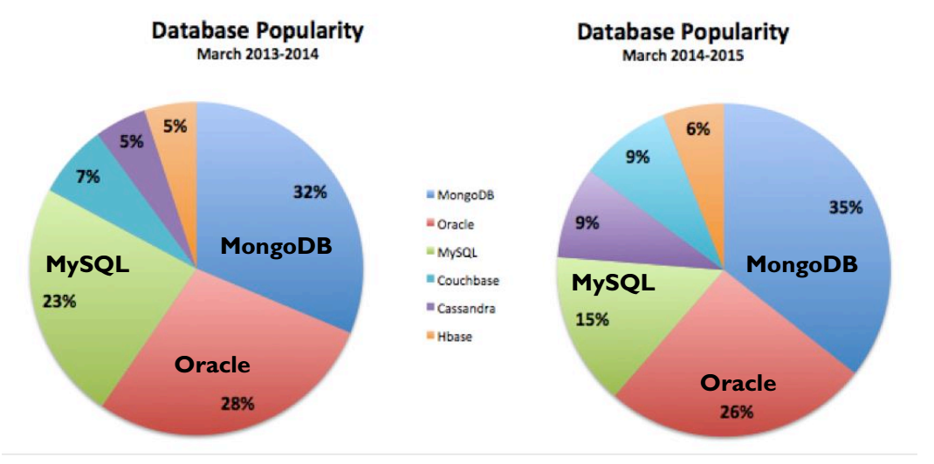
4) NoSql is very hot

Slide 8
Why NoSql is hot
NoSQL has Flexible Data Model
Capture Unstructured / Semi-structured Big Data
2) NoSQL is highly and easily scalable
NoSQL model is an unstructured, scale-out and distributed technology
Notes:
1）
Because of NoSql unstructured way.
2）
RDBMS: RDBMS is a centralized, share-everything technology that scales up rather than out. This made them have a poor performance on the applications that require easy and dynamic scalability.
NoSql: the advantage of scale out: could have several servers to deal with the data.
On the contrast, RDBMS work only in a server. Scale-up Means more CPUs, memory and is more expensive

Slide 9
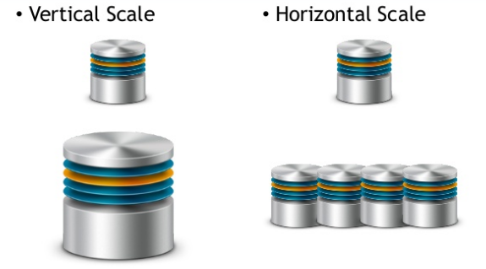
Why NoSql is hot
Notes:
1）
Because of NoSql unstructured way.
2）
RDBMS: RDBMS is a centralized, share-everything technology that scales up rather than out. This made them have a poor performance on the applications that require easy and dynamic scalability.
NoSql: the advantage of scale out: could have several servers to deal with the data.
On the contrast, RDBMS work only in a server. Scale-up Means more CPUs, memory and is more expensive

Slide 10
Why NoSql is hot
3) Dyamic schemas
For relational databases, we need to define schemas before you can add data.
For NoSql, it allows the insertion of data without a predefined schema
4) Auto-sharding
For NoSql model, data and query load are automatically balanced across servers
Notes:
1）
easy to make significant application changes in real-time, without worrying about service interruptions – which means development is faster, code integration is more reliable.
2）
if a server goes down, it can be quickly and transparently replaced with no application disruption. reliable

Slide 11
Thanks!

